Slide 1
Mahaaya Proof of Value
Service Packages Overview

Slide 2

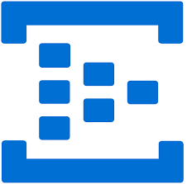

















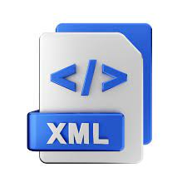



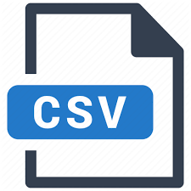
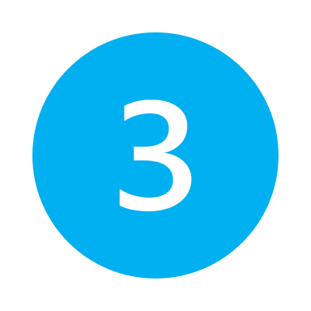







Reference Architecture (Data Value Chain)
Data stream & real time dashboards
Iot devices, big data stream
Event Hub
IoT Hub
Azure Stream Analytics
Business Users
Streaming
Ingest
Near Real Time
ML Ops
Cognitive service
Machine Learning
Enterprise Analytics
databases
Relational
Store
ADLS Medallion
Synapse data explorer pool
Business Intelligence
Batch
Serve
csv, json, xml, logs
Bronze
Silver
Gold
Process
Self-service analytics, business intelligence, data sharing etc.
Semi-structured
Synapse spark pool
Applications
Azure Data Factory
Synapse SQL pool
Images, videos, audio, free text
Microsoft Fabric
Data Sharing
Unstructured
Data Sources
Data Governance (Azure Purview)

Slide 3


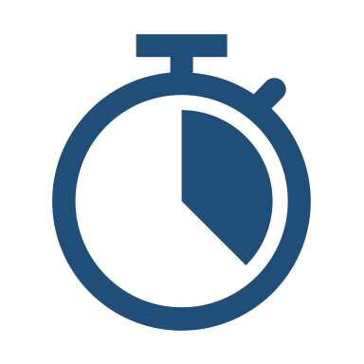
Analytics Modernization POV Overview
Our POV approach is underpinned by 2 key components – a. security & compliance, and b. cost optimization
Assessment & Strategy
POV Implementation
Knowledge Transfer
Collaborate with stakeholders to understand current landscape and pain points
Obtain agreement on desired outcomes
Tailored strategy to map Azure services to your unique needs
Develop 2-week sprints for POV implementation
Data migration and transformation from selected data sources
Data consolidation and scalable Data Warehouse using Azure Synapse Analytics
Azure ML to build foundation models and underscore actionable insights
Azure Power BI for interactive, visually engaging reports and dashboards
Hands on training sessions for the team for smooth transition
Enablement for scaling the solution and maintenance
20k USD
6 Weeks
Key Outcomes:
Foundation for future state
Controlled cost solution validation
Security & Assurance
Improved data accessibility
Enhanced data processing & performance
Deliverables:
Analytical workshops (high value use cases inventory, and pain points)
Proposed Solution Architecture
Competency & RACI matrix
Process / Flow maps for modernization
Value statistics
Proposed implementation path
Project documentation

Slide 4
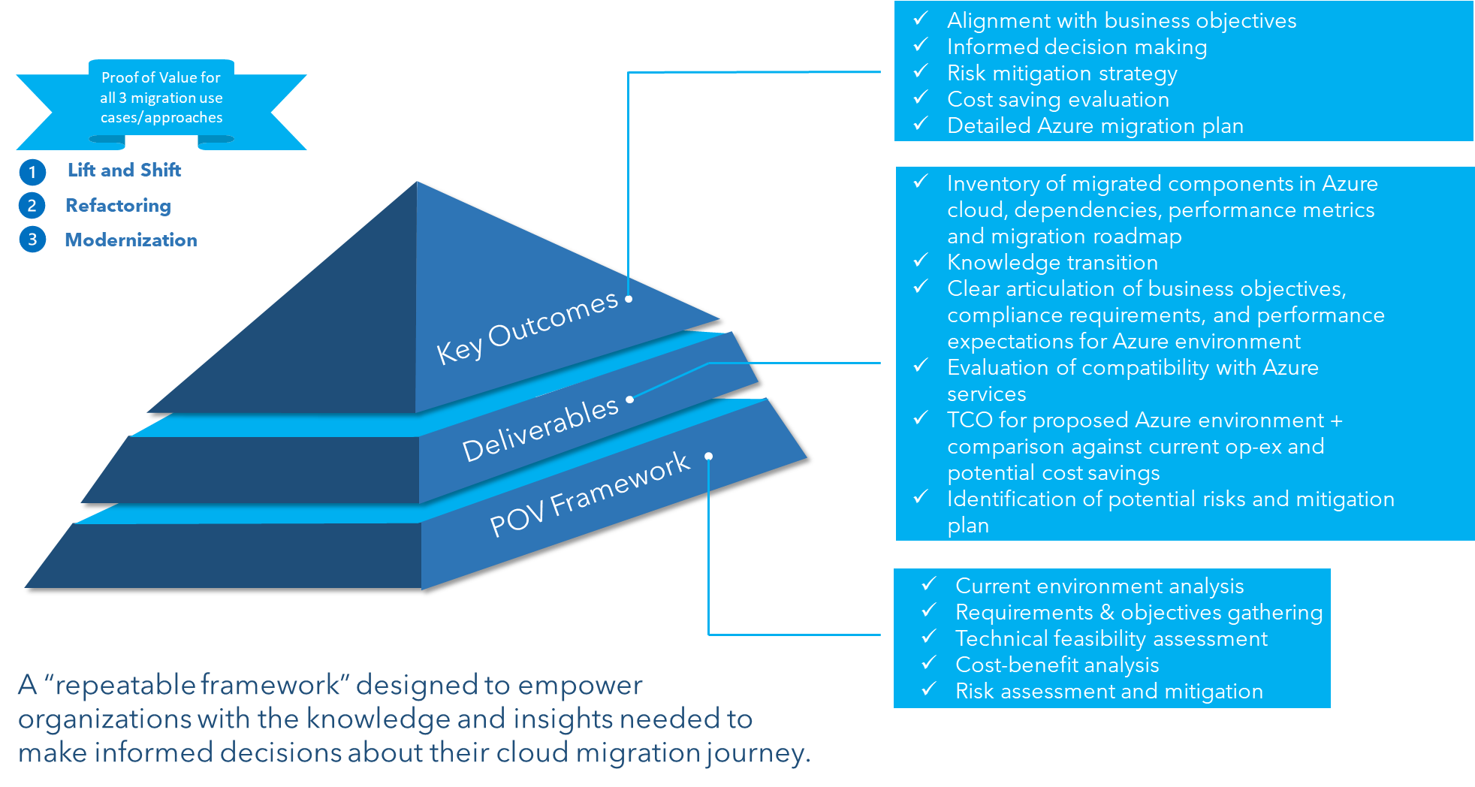
Data and Platform Migration POV Overview
*50-250k USD
*4-12 weeks
* pricing and duration will vary depending on selected/recommended POV use-case/approach

Slide 5
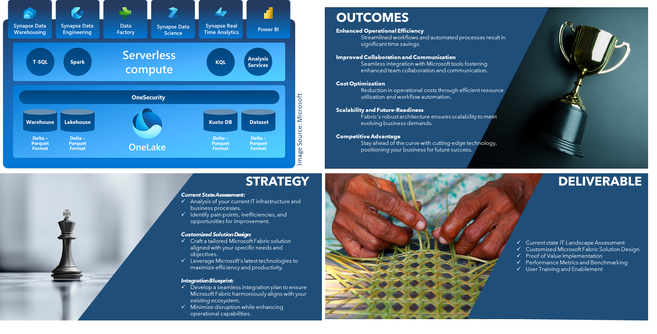
Microsoft Fabric POV Overview
30k USD
2 Weeks

